Slide 1
Introduction to SQL: Structured Query Language By Roxboro Solutions
Session Four
January 2, 2025

Slide 2
Review Syllabus.
Goals:
Basic SELECT statement for data retrieval.
Where clause filter rows.
Using wild cards.
Specifying columns and column aliases.
Order by (Sorting).
Limiting number of rows.
SQL Operators: Arithmetic, Comparison, Logical
SQL Null Functions:
Set Operations: UNION, UNION ALL, INTERSECT, EXCEPT
Sub queries.
Primary & Foreign Keys
Joins: INNER, LEFT, RIGHT, SELF, OUTER.
Aggregates: COUNT, SUM, AVG, MIN, MAX.
Group By and Having (filter).
Views.
Temp tables (with)
CASE statements.
Date functions.
String functions.
Numeric Functions.
Stored Procedures.

Slide 3
Aggregates:
Calculate a value of a column on one or more rows.
COUNT: counts how many rows are in a particular column.
AVG: calculates the average of a group of selected values.
MIN: return the lowest value in a particular column.
MAX: return the highest value in a particular column
SUM: adds together all the values in a particular column.

Slide 4
Syntax
SELECT AVG(columns)…
FROM table
WHERE Boolean-expression
GROUP BY columns…
HAVING Boolean-expression
ORDER BY columns…

Slide 5
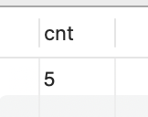
COUNT (* | column)
SELECT COUNT(*) FROM table
SELECT COUNT(*) AS cnt FROM customer;

Slide 6
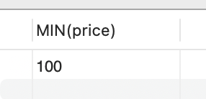
MIN
SELECT MIN(column) FROM Table
SELECT MIN(price) FROM items;

Slide 7
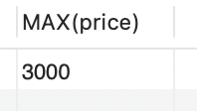
MAX
SELECT MAX(column) FROM {Table}
SELECT MAX(price) FROM items;

Slide 8
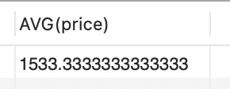
AVG
SELECT AVG(column) FROM table
SELECT AVG(price) FROM items

Slide 9
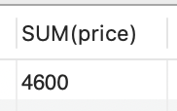
SUM
SELECT SUM(column) FROM table
SELECT SUM(price) FROM items

Slide 10

Putting it all together.
SELECT COUNT(*) AS total_rows,
MIN(price) AS min_price,
MAX(price) AS max_price,
AVG(price) AS avg_price,
SUM(price) AS sum_price
FROM items;

Slide 11
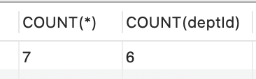
More on COUNT and the effect of NULL
SELECT COUNT(*), COUNT(deptId) FROM employees;

Slide 12
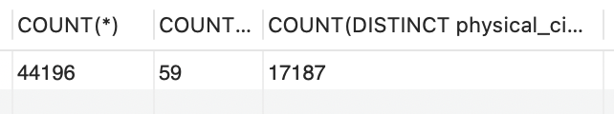
COUNT DISTINCT
SELECT COUNT(*),
COUNT(DISTINCT physical_state),
COUNT(DISTINCT physical_city)
FROM zipcodes;

Slide 13
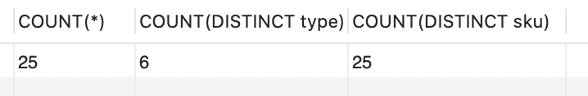
VERIFY WITH SELECT DISTINCT
SELECT COUNT(*),
COUNT(DISTINCT type),
COUNT(DISTINCT sku)
FROM products;

Slide 14
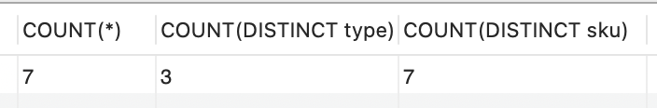
COUNT with WHERE clause:
SELECT COUNT(*),
COUNT(DISTINCT type),
COUNT(DISTINCT sku)
FROM appjedin_student_temp.products
WHERE saleprice>0

Slide 15
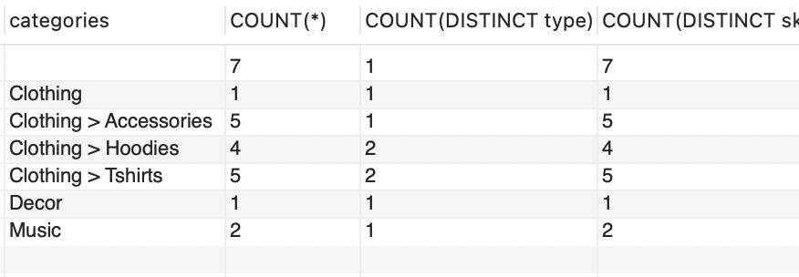
COUNT with GROUP BY clause:
SELECT categories,
COUNT(*),
COUNT(DISTINCT type),
COUNT(DISTINCT sku)
FROM products
GROUP BY categories
Rule: Everything you GROUP BY must be in the SELECT line.

Slide 16
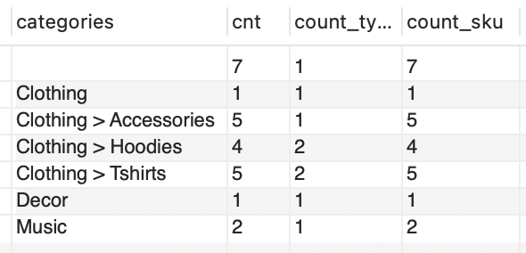
COUNT with Column Aliases:
SELECT categories,
COUNT(*) AS cnt,
COUNT(DISTINCT type) AS count_type,
COUNT(DISTINCT sku) AS count_sky
FROM products
GROUP BY categories

Slide 17
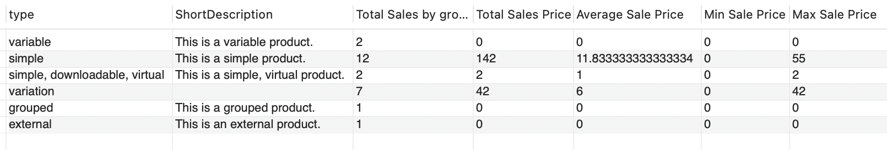
GROUP BY multiple columns:
SELECT `type`,ShortDescription,
COUNT(*) AS `Total Sales by group`,
SUM(SalePrice) AS `Total Sales Price`,
AVG(SalePrice) AS `Average Sale Price`,
MIN(SalePrice) AS `Min Sale Price`,
MAX(SalePrice) AS `Max Sale Price`
FROM appjedin_student_temp.products
GROUP BY `type`,ShortDescription;

Slide 18
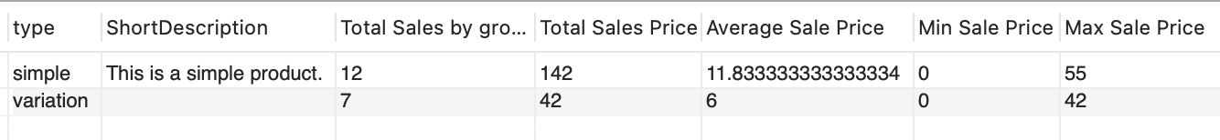
HAVING
HAVING is like a WHERE clause for GROUPS
SELECT `type`,ShortDescription,
COUNT(*) AS `Total Sales by group`,
SUM(SalePrice) AS `Total Sales Price`,
AVG(SalePrice) AS `Average Sale Price`,
MIN(SalePrice) AS `Min Sale Price`,
MAX(SalePrice) AS `Max Sale Price`
FROM appjedin_student_temp.products
GROUP BY `type`,ShortDescription
HAVING COUNT(*) >2;

Slide 19
HAVING vs. WHERE
WHERE clause filters rows of data.
HAVING clause filters groups of data.
SELECT `type`,ShortDescription,
COUNT(*) AS `Total Sales by group`,
SUM(SalePrice) AS `Total Sales Price`,
AVG(SalePrice) AS `Average Sale Price`,
MIN(SalePrice) AS `Min Sale Price`,
MAX(SalePrice) AS `Max Sale Price`
FROM appjedin_student_temp.products
WHERE SalePrice>0
GROUP BY `type`,ShortDescription

Slide 20
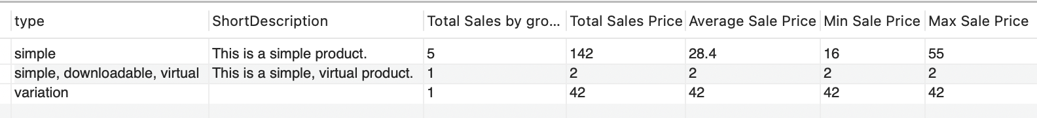
HAVING vs. WHERE Cont.

Slide 21
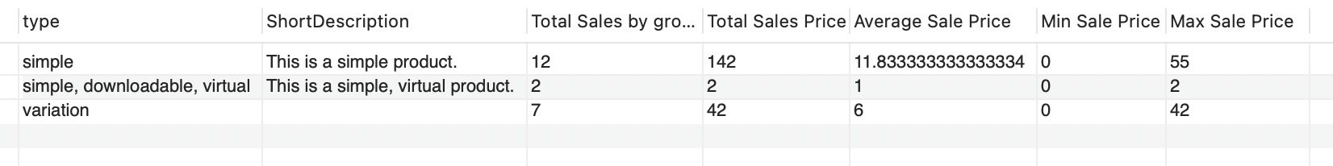
HAVING vs. WHERE Cont.
SELECT `type`,ShortDescription,
COUNT(*) AS `Total Sales by group`,
SUM(SalePrice) AS `Total Sales Price`,
AVG(SalePrice) AS `Average Sale Price`,
MIN(SalePrice) AS `Min Sale Price`,
MAX(SalePrice) AS `Max Sale Price`
FROM appjedin_student_temp.products
GROUP BY `type`,ShortDescription
HAVING SUM(SalePrice)>0

Slide 22
Simplifying it with views.
In SQL, a view is a virtual table based on the result-set of an SQL statement. A view contains rows and columns, just like a real table
The SQL statement is saved under the view name but not the data.

Slide 23
Example
CREATE VIEW view_sales_report AS
SELECT `type`,ShortDescription,
COUNT(*) AS `Total Sales by group`,
SUM(SalePrice) AS `Total Sales Price`,
AVG(SalePrice) AS `Average Sale Price`,
MIN(SalePrice) AS `Min Sale Price`,
MAX(SalePrice) AS `Max Sale Price`
FROM appjedin_student_temp.products
GROUP BY `type`,ShortDescription
HAVING SUM(SalePrice)>0

Slide 24
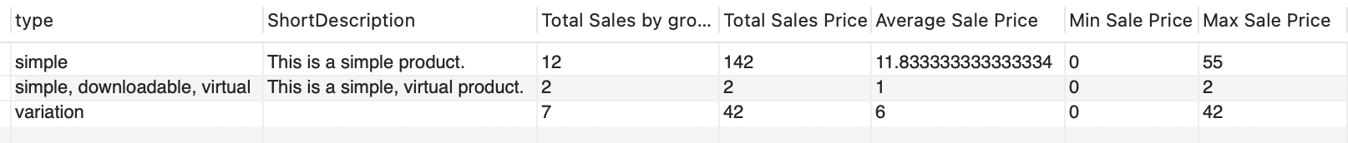
Using the View
SELECT * FROM view_sales_report;

Slide 25
View for Customer Purchases
CREATE VIEW view_customer_purchases AS
SELECT c.*, city.city, city.state, o.datePlaced,o.dateShipped, o.status, ol.quantity, p.name AS `Product Name`
FROM appjedin_student_temp.customer c
JOIN city ON c.zip=city.zip
LEFT JOIN `order` o ON c.ID=o.customerID
JOIN orderline ol ON o.id = ol.orderId
JOIN product p ON ol.productId =p.id

Slide 26
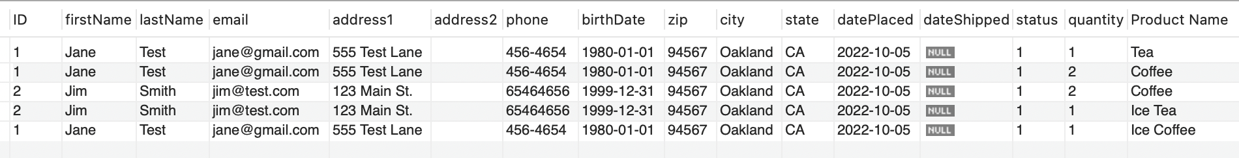
Using the view
SELECT * FROM view_customer_purchases;

Slide 27
NEXT
Questions? Please post to the comments section.
Views continued.
Temp tables (with).
CASE.
Please like and subscribe.
https://www.appjedi.net

